Slide 1
Chicago crime
2015-2020
Hidaya Jazbi & Mohammad albarabrah

Slide 2
Introduction
We analyzed the Chicago Violent Crime Dataset covering the years 2015–2020, which includes detailed records of robbery, homicide, criminal sexual assault, and kidnapping. The dataset contains information such as the crime type, date, location, arrest status, and descriptive details.
Why We Chose This Dataset
We chose this dataset because violent crime is a major real-world issue, and analyzing it helps us understand how data can reveal important patterns that affect public safety. It also allowed us to practice data cleaning, grouping, visualization, and trend analysis using Python.

Slide 3
Dataset Summary
70,748 violent crime records (2015–2020)
Columns: crime type, date, arrest, year, month, location, description
Focus on 4 violent crimes
robbery, homicide, criminal sexual assault, and kidnapping

Slide 4
Questions We Answered
How has the total violent crime changed over 2015 to 2020?
What types of violent crime are most common?​
How do arrest rates vary by crime type and by year?​
Are there seasonal patterns in violent crime?

Slide 5
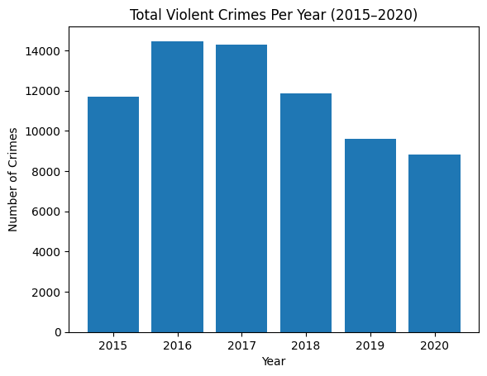
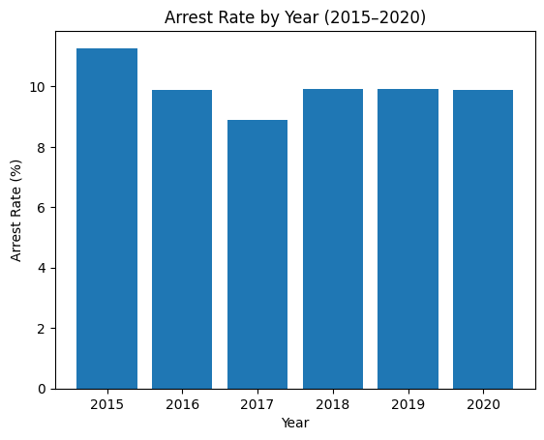
Crime Trends Over Time
How has the total violent crime changed over 2015 to 2020?
How do arrest rates vary by year?​
-Shows peak in 2016–2017
-Significant drop by 2020
-Highest in 2015
-Stable around ~9–10% after

Slide 6
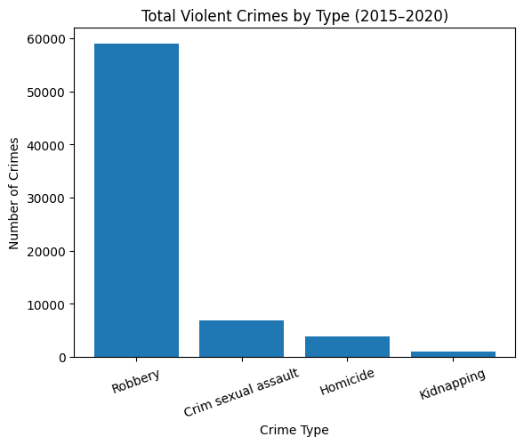
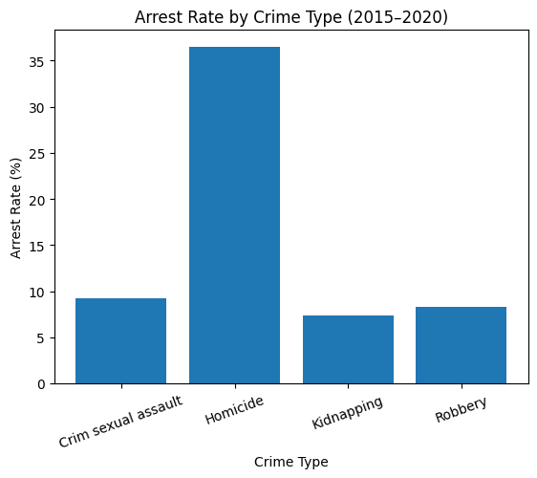
Crime Types & Arrest Rates
What types of violent crime are most common?​
How do arrest rates vary by crime type?
– Robbery overwhelmingly most common
– Sexual assault, homicide, and kidnapping much lower
– Homicide has the highest arrest rate (~36%)
– Other crimes between 7–9%

Slide 7
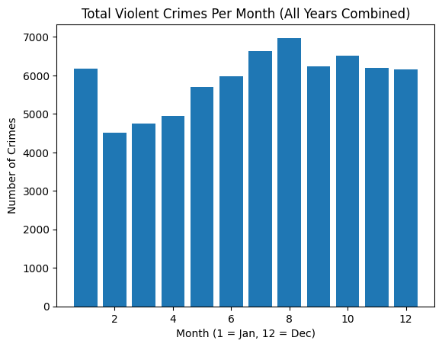
Seasonal Patterns
Are there seasonal patterns in violent crime?
– Crime lowest Feb–Apr
– Crime peaks July–August

Slide 8
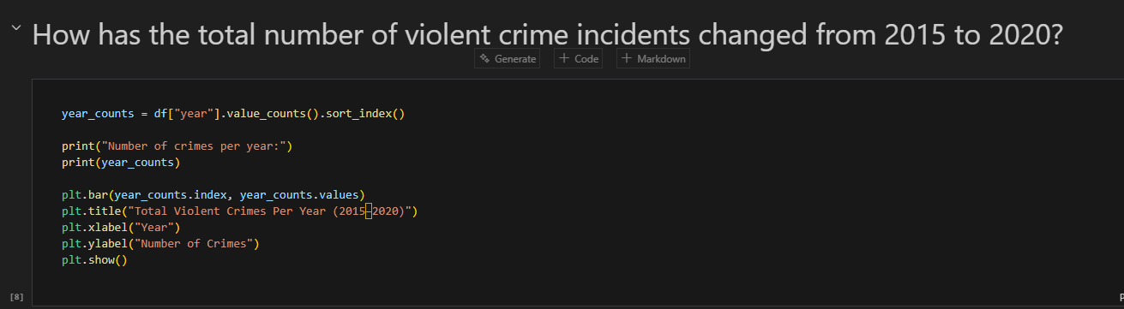
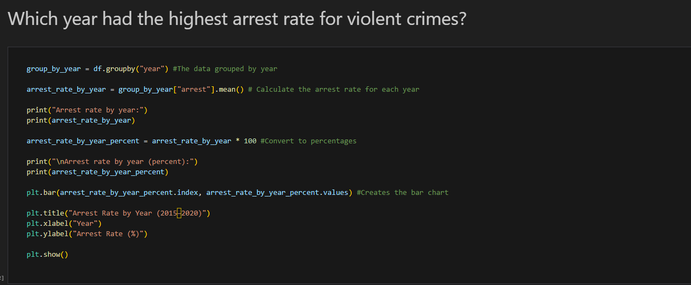
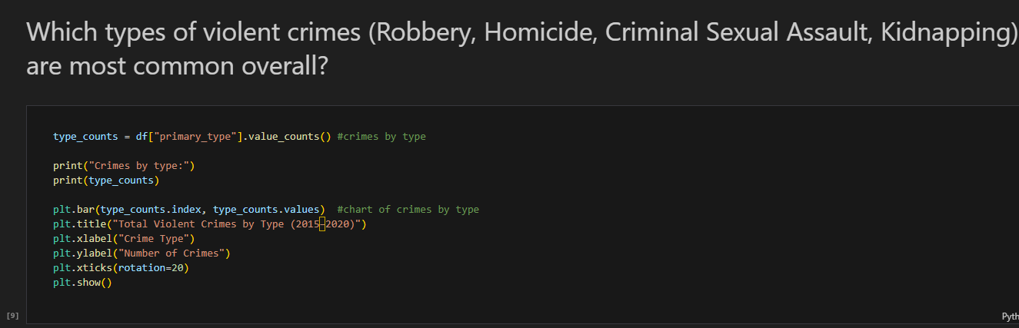
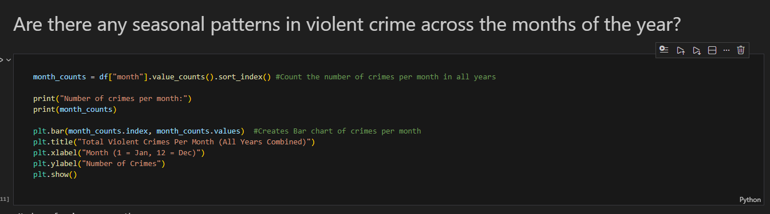
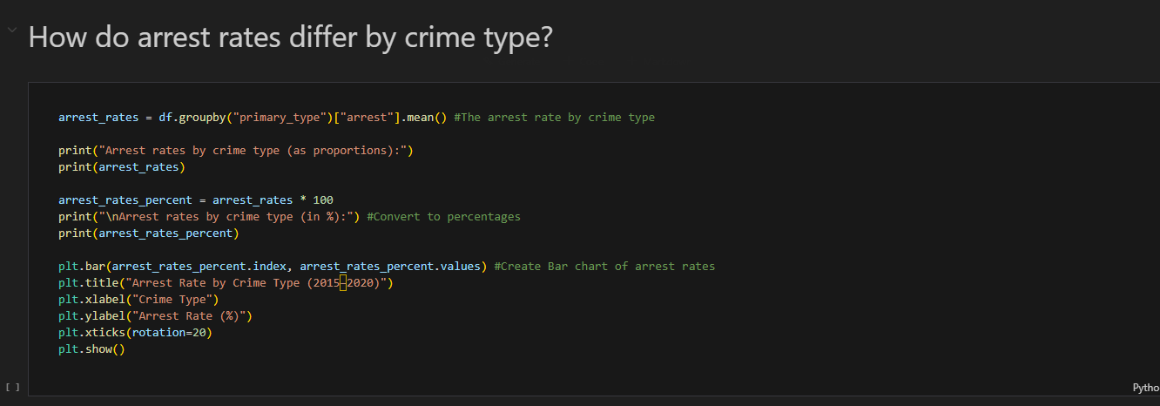

Slide 9
Conclusion
Through this project, we explored the Chicago violent crime dataset by cleaning the data, extracting key variables, and using Python to calculate totals, arrest rates, and monthly/annual patterns. By creating bar charts and analyzing trends, we were able to turn raw data into meaningful insights about how violent crime changes over time, which crime types are most common, and when crime is most likely to occur. This process showed how data analysis can reveal patterns that are not visible just by looking at numbers in a table.

Slide 10
References
Dataset Link: https://www.kaggle.com/datasets/redlineracer/chicago-crime-2015-2020
GitHub Repository Link: https://github.com/hidayajazbi/Chicago-Crime.git

